Slide 1
Advanced Networking Technology
Fall 2020
赵振刚 gavin@ustc.edu.cn

Slide 2
Chapter 1 Introduction
1. What is a network？
2. What is computer network?
3. What is the design principal of network?
4. What is advanced network？
5. Syllabus

Slide 3
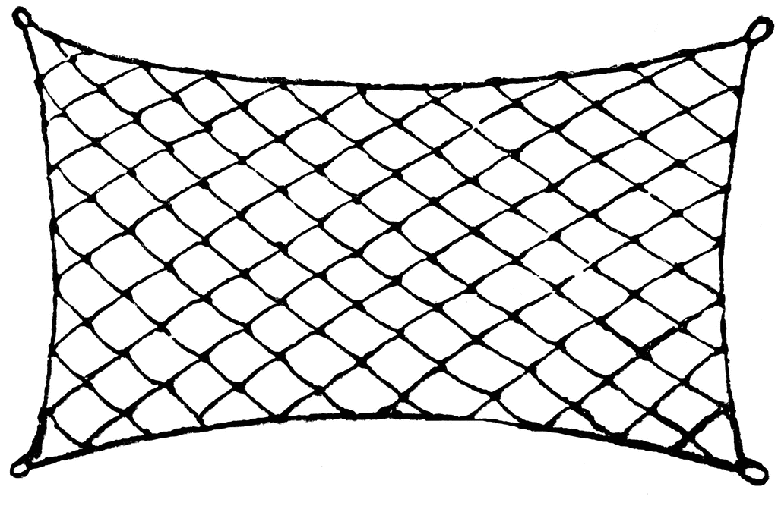

1. What is a network?
any netlike combination of filaments, lines, veins, passages, or the like
Spider Web

Slide 4
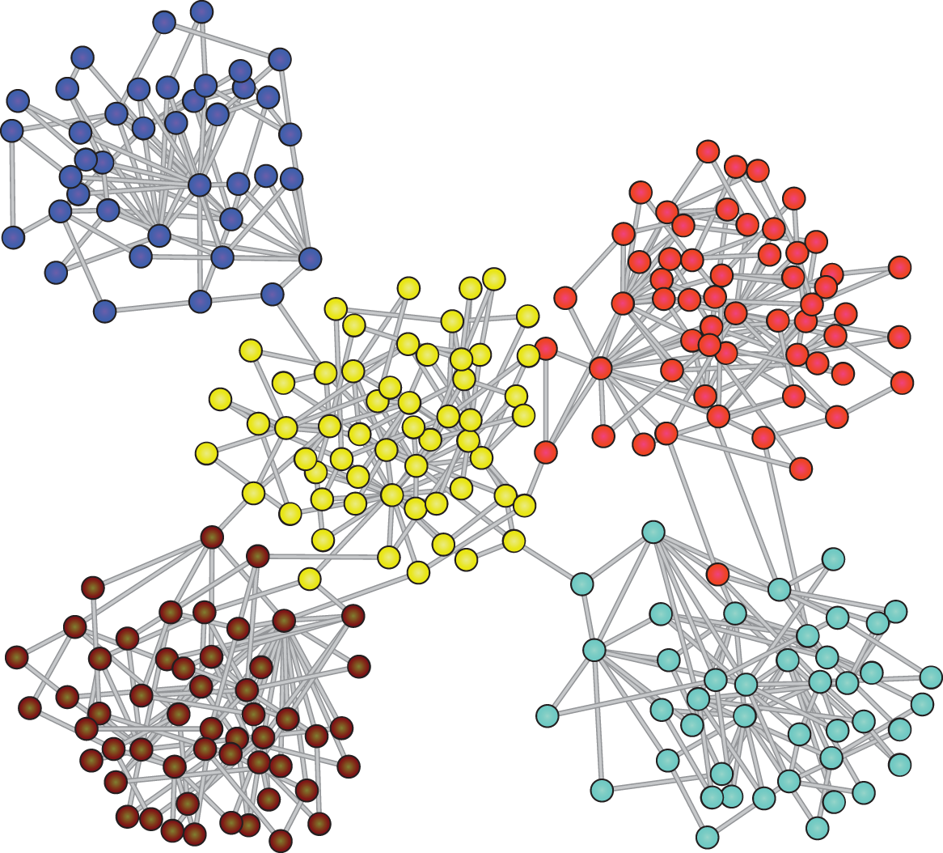
1. What is a network?
Biological network , networks found in ecological, evolutionary, and physiological contexts
Notes:
Complex biological systems may be represented and analyzed as computable networks. For example, ecosystems can be modeled as networks of interacting species or a protein can be modeled as a network of amino acids.

Slide 5
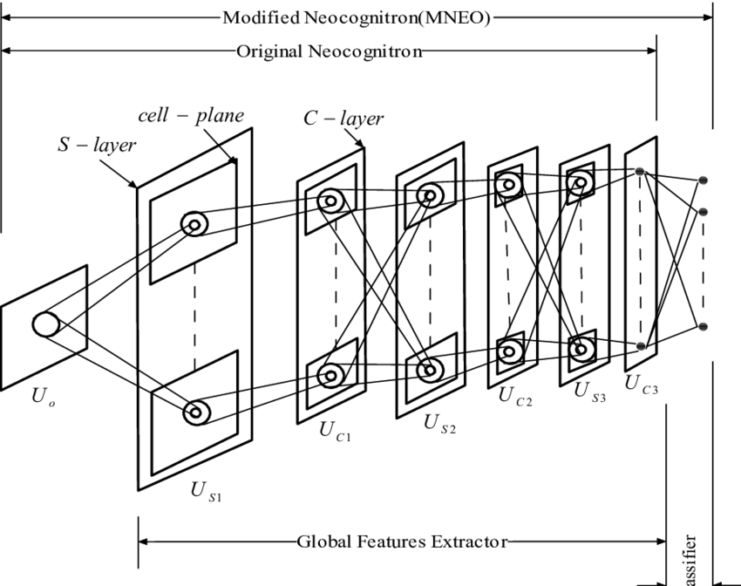
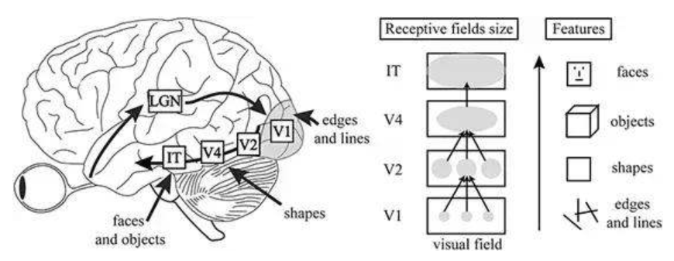
1. What is a network?
Neural network
Notes:
作为整体的人工神经网络受到20世纪中期正在兴起的神经元新兴生物学的启发, 1962年，Hubel和Wiesel发现，初级视觉皮层中的神经元对视觉环境中特定的简单特征（特别是定向边缘）有反应。此外，他们注意到两种不同类型的细胞：简单的细胞（它们只在非常特定的空间位置对它们的优选取方向作出最强烈的反应）和复杂的细胞（它们的反应具有更多的空间不变性）。Neocognitron由Kunihiko Fukushima在1980年开发，综合了目前关于生物视觉的知识，试图构建一个功能性的人造视觉系统。neocognitron由“S-cells”和“C-cells”组成，并通过无监督学习来学习识别简单图像

Slide 6
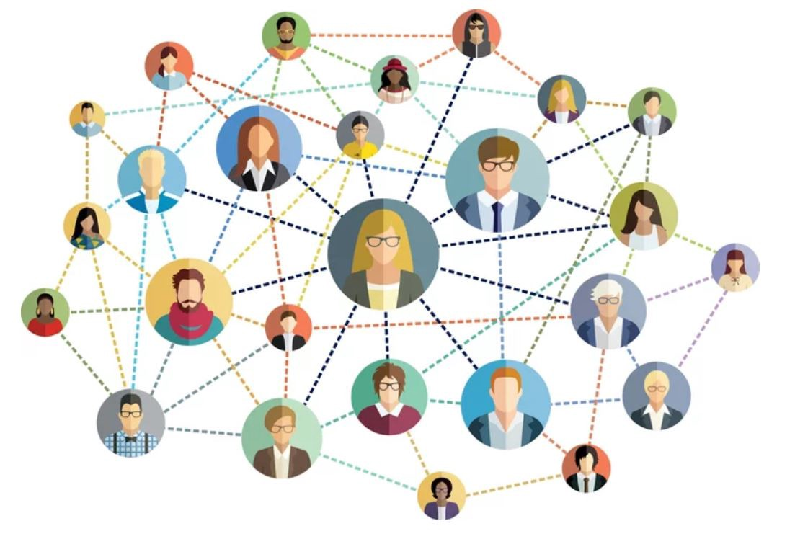
1. What is a network?
Social network , in social science research
Scientific collaboration network , a social network wherein nodes are scientists and links are co-authorships

Slide 7
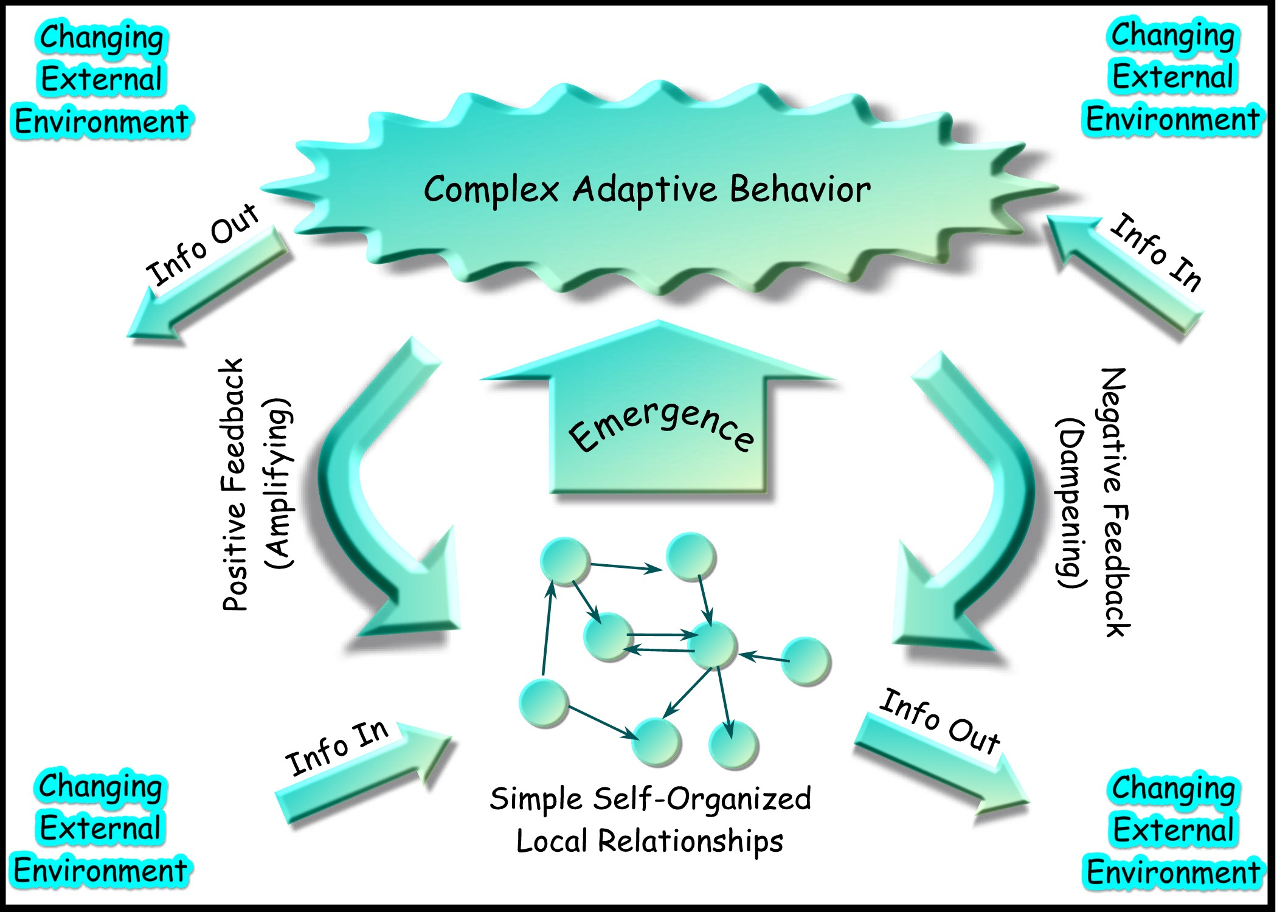
1. What is a network?
Network science , an academic field which studies complex networks

Slide 8
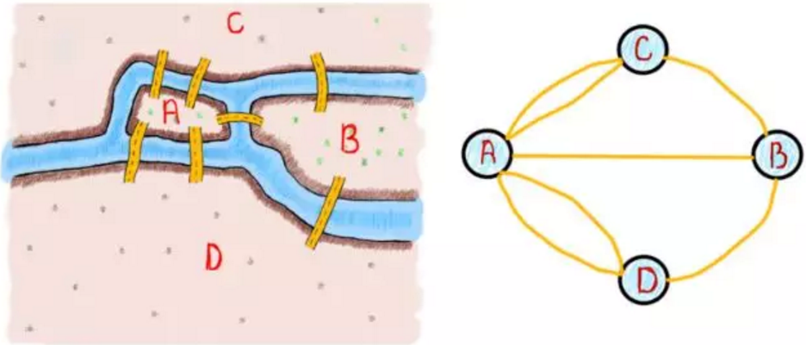
1. What is a network?
Network theory , the study of graphs as a representation of relations between discrete objects
G=(V, E)
Seven bridges of Königsberg

Slide 9
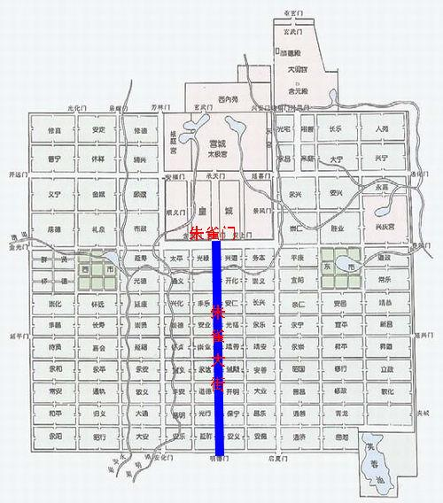
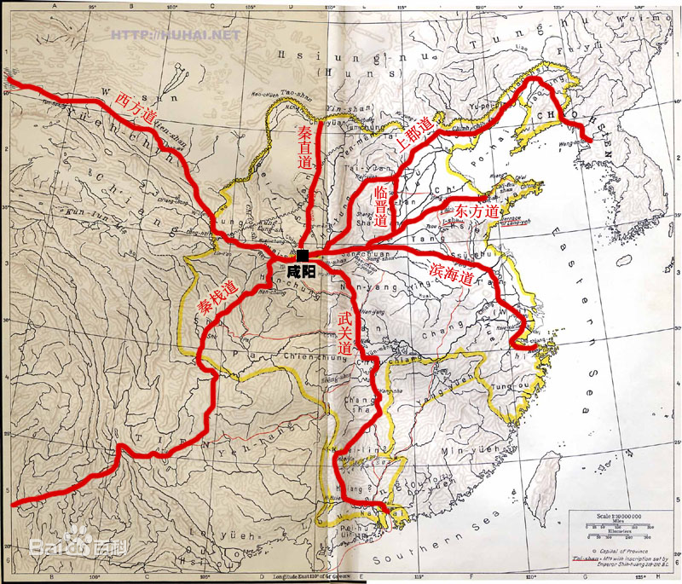
1. What is a network?
Network Technology , which concerns engineering problems
Notes:
先秦时期的周道,秦汉时的驰道,唐宋时的驿道,驰道是中国历史上最早的“国道”，始于秦朝

Slide 10
1. What is a network?
Nodes, Connections, Transport
Node centrality, Node influence
Connectedness
Size, Density, Average degree
Average shortest path length (or characteristic path length)
Optimal path
Throughout, Delay
……
Notes:
网络的基本属性和问题

Slide 11
Chapter 1 Introduction
1. What is a network？
2. What is computer network?
3. What is the design principal of network?
4. What is advanced network？
5. Syllabus

Slide 12
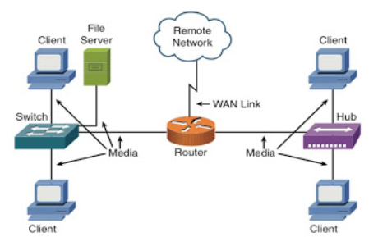
2. What is computer network?
A computer network is a group of computers that use a set of common communication protocols over digital interconnections for the purpose of sharing resources located on or provided by the network nodes .

Slide 13



What’s a protocol?
a human protocol and a computer network protocol:
Hi
TCP connection
request
Hi
TCP connection
response
Got the
time?
Get http://www.awl.com/kurose-ross
2:00
<file>
time
Q: other human protocols?
Introduction
1-13

Slide 14
Protocols and Standards
Protocol，协议
A set of rules that governs data communication
3 key elements
Syntax 语法、Semantics 语义 、Timing 时序
What、How、When
Standard，标准
Agreed-upon rules
Categories
De-facto 事实上的标准：by fact or by convention
De-jury 合法标准：by law or by regulation
同步：Synchronization
Notes:
网络协议包含3个key elements，分别是Syntax 语法、Semantics 语义 、Timing 时序，试分析 纸质邮件通信中这三个部分的实例分别是什么。网络层中这三个要素又分别是什么？

Slide 15
Analogy
Network | What is Flowing | Different Forms | Rules | Where
Highway | Vehicles | Trucks, cars, cycles | Traffic laws and rules for politeness | Roads and Highways
Postal | Objects | Letters, packages | Rules for packaging and attaching postage | Postal service-boxes, offices, trucks, planes, delivery people
Telephone | Information | Spoken languages | Rules for accessing phone and rules for politeness | Phone system-wires, EM waves, etc.

Slide 16
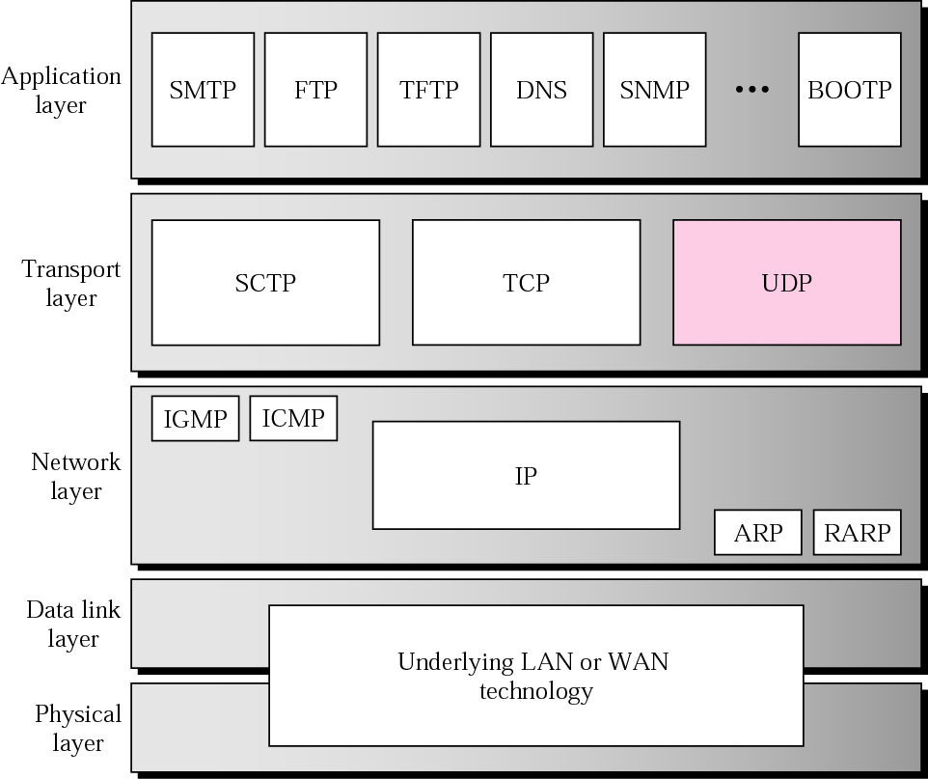
Protocols and Standards
Protocol layers

Slide 17
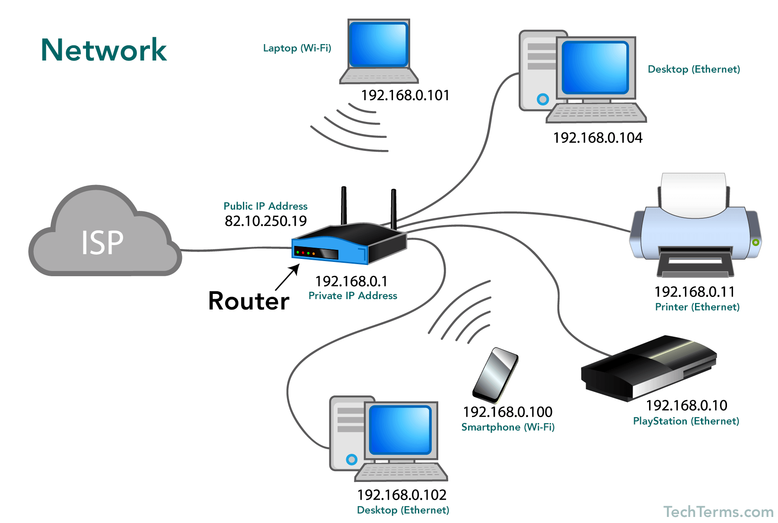
2. What is computer network?
The nodes of a computer network may be classified by many means as personal computers , servers , networking hardware , or general purpose hosts . They are identified by hostnames and network addresses.
Notes:
Nodes, Connections, Transport

Slide 18
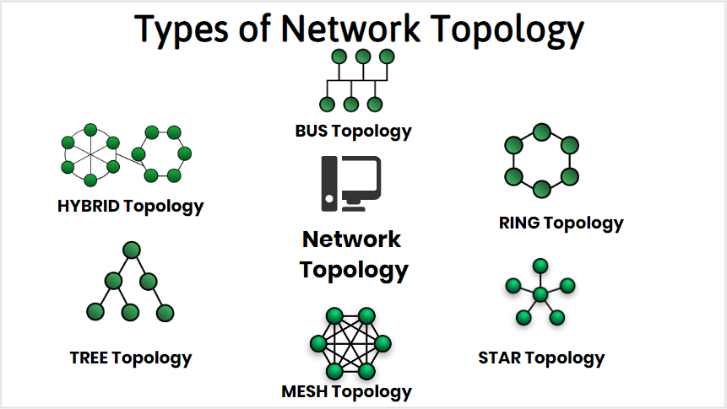
2. What is computer network?
The interconnections between nodes are formed from a broad spectrum of telecommunication network technologies, based on physically wired, optical, and wireless radio-frequency methods that may be arranged in a variety of network topologies.
Notes:
Nodes, Connections, Transport

Slide 19
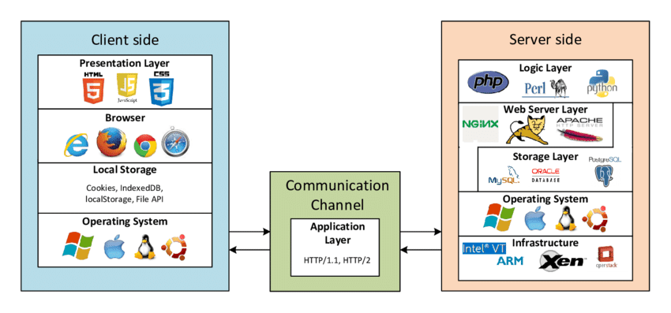
2. What is computer network?
Computer networks support many applications and services , such as access to the World Wide Web , digital video , digital audio , shared use of application and storage servers , printers and so on.
Notes:
Nodes, Connections, Transport

Slide 20
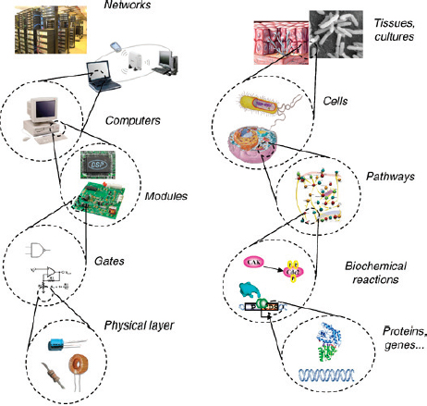
2. What is computer network?

Slide 21


2. What is computer network?
Nodes, Connections, Transport
Encode
Decode

Slide 22
Chapter 1 Introduction
1. What is a network？
2. What is computer network?
3. What is the design principal of network?
4. What is advanced network？
5. Syllabus

Slide 23
1.3.1 A Brief History of Computer Network
Computer networking may be considered a branch of computer science , computer engineering , and telecommunications , since it relies on the theoretical and practical application of the related disciplines.
Computer networking was influenced by a wide array of technology developments and historical milestones.
Notes:
ARPANET：Advanced Research Project Agency Network, NCP：Network Control Protocol
MILNET：Military Network, NSFNET：National Science Foundation Network

Slide 24
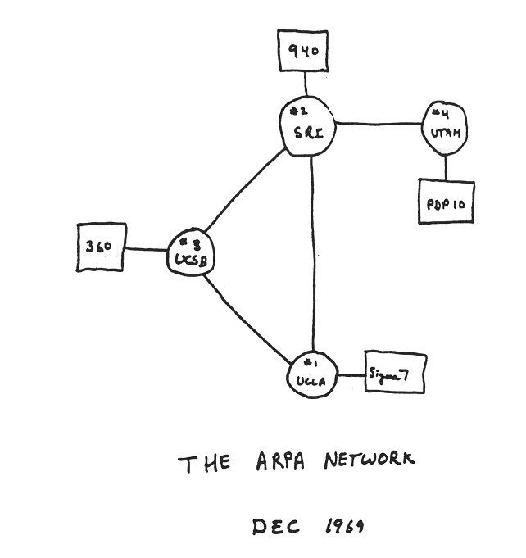
1961-1972: Early packet-switching principles
1961: Kleinrock - queueing theory shows effectiveness of packet-switching
1964: Baran - packet-switching in military nets
1967: ARPAnet conceived by Advanced Research Projects Agency
1969: first ARPAnet node operational
1972:
ARPAnet public demo
NCP (Network Control Protocol) first host-host protocol ,RFC001
first e-mail program
ARPAnet has 15 nodes
Introduction
1-24
Notes:
ARPA，1967年，田纳西州的ACM

Slide 25
1972-1980: Internetworking, new and proprietary nets
1970: ALOHAnet satellite network in Hawaii
1974: Cerf and Kahn - architecture for interconnecting networks
1976: Ethernet at Xerox PARC
late70’s: proprietary architectures: DECnet, SNA, XNA
late 70’s: switching fixed length packets (ATM precursor)
1979: ARPAnet has 200 nodes
Cerf and Kahn’s internetworking principles:
minimalism, autonomy - no internal changes required to interconnect networks
best effort service model
stateless routers
decentralized control
define today’s Internet architecture
Introduction
1-25
Notes:
In 1972, commercial services using X.25 were deployed, and later used as an underlying infrastructure for expanding TCP/IP networks.
简单化，网络自治，网络之间不需要数据变换；Bob Metcalfe提出以太网，并由Xerox公司创建并由Xerox、Intel和DEC公司联合开发的基带局域网规范

Slide 26
1980-1990: new protocols, a proliferation of networks
1983: deployment of TCP/IP
1982: smtp e-mail protocol defined
1983: DNS defined for name-to-IP-address translation
1985: ftp protocol defined
1988: TCP congestion control(Host/End)
new national networks: Csnet, BITnet, NSFnet, Minitel
100,000 hosts connected to confederation of networks
Introduction
1-26
Notes:
1983.1.1 NCP-→TCP
Minitel,based on X.25(virtual circuit)

Slide 27
1990, 2000’s: commercialization, the Web, new apps
early 1990’s: ARPAnet decommissioned
1991: NSF lifts restrictions on commercial use of NSFnet (decommissioned, 1995)
early 1990s: Web
hypertext [Bush 1945, Nelson 1960’s]
HTML, HTTP: Berners-Lee
1994: Mosaic, later Netscape
late 1990’s: commercialization of the Web
late 1990’s – 2000’s:
more killer apps: instant messaging, P2P file sharing
network security to forefront
est. 50 million host, 100 million+ users
backbone links running at Gbps
Introduction
1-27

Slide 28
2005-present
~750 million hosts
Smartphones and tablets
Aggressive deployment of broadband access
Increasing ubiquity of high-speed wireless access
Emergence of online social networks:
Facebook: soon one billion users
Service providers (Google, Microsoft) create their own networks
Bypass Internet, providing “instantaneous” access to search, emai, etc.
E-commerce, universities, enterprises running their services in “cloud” (eg, Amazon EC2)
By 1998, Ethernet supported transmission speeds of a Gigabit. Subsequently, higher speeds of up to 400 Gbit/s were added (as of 2018 ).
Introduction
1-28

Slide 29
Key Terms
Network，网络
A group of connected, communicating devices
internet / internetwork，互联网（网际网）
Two or more networks that can communicate with each other
互联形成的网络集合
interconnect，互联/互连
internetworking，网际互联/互连
Internet，因特网
The most notable internet in the world, running on TCP/IP

Slide 30



















Internet: “nuts and bolts” view
PC
millions of connected computing devices:
hosts = end systems
running network apps
mobile network
server
wireless
laptop
global ISP
smartphone
home
network
communication links
fiber, copper, radio, satellite
transmission rate: bandwidth
regional ISP
wireless
links
wired
links
Packet switches: forward packets (chunks of data)
routers and switches
router
institutional
network
Introduction
1-30
Notes:
30
nuts and bolts 螺母和螺栓

Slide 31
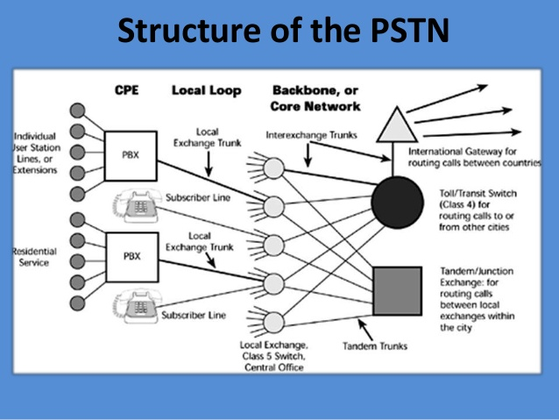
3. What is the design principal of network?
Telcom approach: “Smart CORE, Dumb Terminal”
The core ensures correctness (e.g., reliability)
Notes:
Signaling

Slide 32
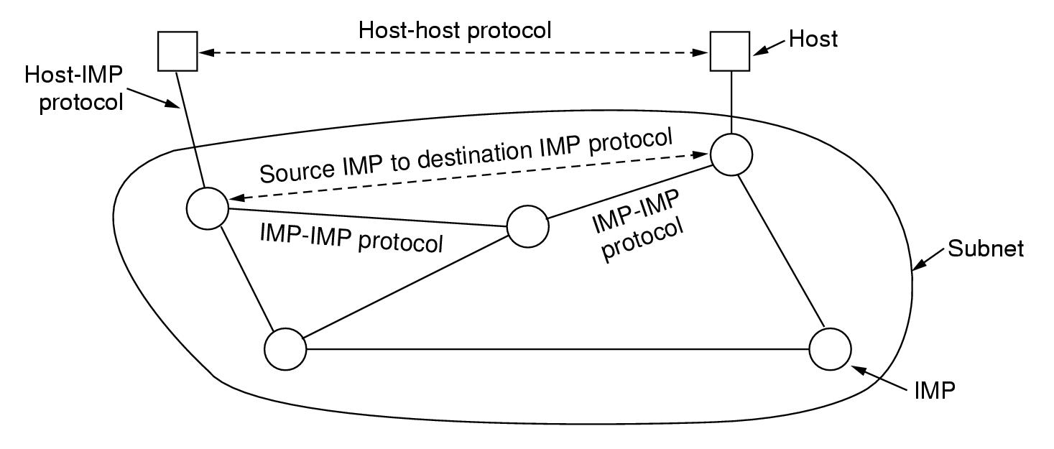
The Original ARPANET Design
3. What is the design principal of network?

Slide 33
Architecture of the Internet
Physical networks are interconnected by routers
Hosts are attached to one of the physical networks
R
R
R
R
R
R
R
Router
Physical network

Slide 34
3. What is the design principal of network?
TCP/IP approach: “Smart Terminal, Dumb CORE”
R
R
R
R
R
R

Slide 35
3. What is the design principal of network?
The Growing of Internet
Common factors
New protocols
New technologies
More and more multimedia applications

Slide 36
3. What is the design principal of network?
The Growing of Internet
Hidden factors
Entropy is additive
Social/Commercial
Ecosystem

Slide 37
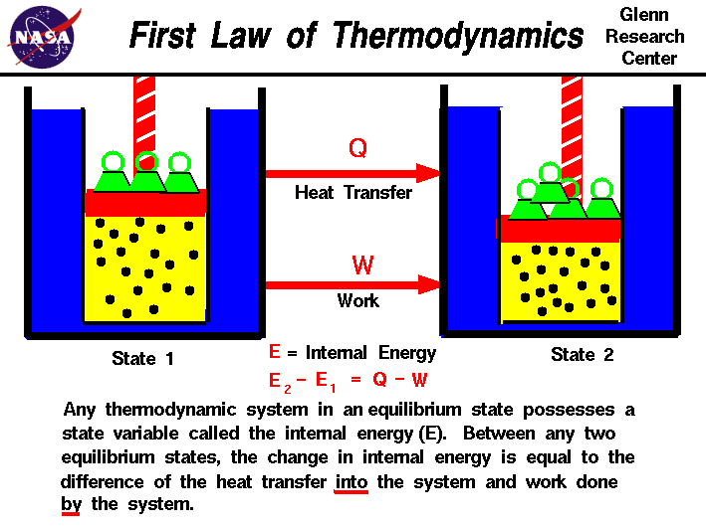
3. What is the design principal of network?
Entropy is additive
Notes:
热力学第一定律就是不同形式的能量在传递与转换过程中守恒的定律，表述形式为热量可以从一个物体传递到另一个物体，一个处于热平衡的系统有一个内部能量E

Slide 38
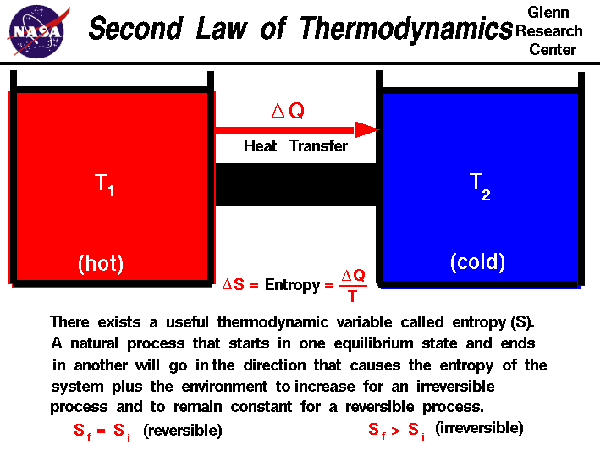
3. What is the design principal of network?
Entropy is additive
Notes:
分子的热运动总是会从原来集中、有序的的排列状态逐渐趋向分散、混乱的无序状态，系统从有序向无序的自发过程中，熵总是增加。热力学第二定律指出,在封闭系统中,任何过程都可以保持熵的总值不变或增加，从现代（量子）观点来看，热力学熵实际上来源于系统与环境的纠缠熵。换句话说，熵增描述的无非是系统信息不断丧失的过程。熵增原理的使用条件很局限：1.孤立系统（近似的，绝热的）2.不可逆过程（一切实际过程）

Slide 39
3. What is the design principal of network?
Entropy is additive
If two systems with entropy S1 and S2, respectively, are brought into contact with each other, their combined entropy equals S1 + S2.

Slide 40
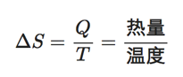
Information Entropy
Entropy来源于希腊语，原意：内向，即：一个系统不受外部干扰时往内部稳定状态发展的特性。
物理学中定义的熵其实是一个热力学的系统变化的趋势。
Notes:
1923年，德国科学家普朗克来中国讲学用到entropy这个词，胡刚复教授看到这个公式，创造了“熵”字，因为“火”和热量有关，定义式又是热量与温度的商，相当自洽； 熵变，即为热量的变化除以系统绝对温度。
在生态学中，熵表示生物多样性的指标。
广义的定义：熵是描述一个系统的无序程度的变量；同样的表述还有，熵是系统混乱度的度量，一切自发的不可逆过程都是从有序到无序的变化过程，向熵增的方向进行。

Slide 41
Information Entropy
信息论中，熵是接受的每条消息中包含的信息的平均值，又被称为信息熵、信源熵、平均自信息量。可以被理解为不确定性的度量，熵越大，信源的分布越随机。
如何用数学符号衡量不确定事物的发生？
比如天气情况，假设可能有【阴、晴、雨、雪】四种情况，使用概率符号表示P=[p₁, p₂, p₃, p₄]，接下来自然而然的思考：那么，什么条件（情况）会影响这些值呢？
今天是晴天，所以明天可能也是晴天
天气预报说明天下雨
9月12日苹果公司举行发布会
第二条的信息量更大，因为它可以使得不确定事件发生在p₃的概率更大。类似的，第三条对判断毫无帮助，信息量为0
Notes:
注意，信息量不等于信息熵，如果是这样，那么直接用概率来衡量就可以了，不需要再重新定义一个概念。

Slide 42
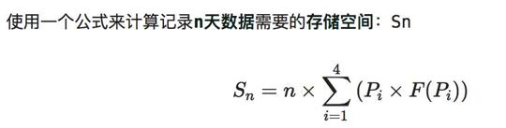
Information Entropy
考虑到信息冗余，信息量存储下来究竟需要多大空间？
仍然由P=[p₁, p₂, p₃, p₄]，来表示天气情况，那么用计算机来存储每天的天气，那该如何编码呢？
常见的做法是，4个不同的信息，需要2bit就能表示，00 01 11 10
更一般地，信息熵是信息量的期望（均值），它不是针对每条信息，而是针对整个不确定性结果集而言，信息熵越大，事件不确定性就越大，比如 一段时间内天气不确定性的描述
Notes:
假设我们在南方城市，肯定要把00编码成雨天，这样可以节省存储空间，至于为什么能节省存储空间，这就要讨论编码方式。可以简单的理解为，如果一串信息一串0很多，可以通过编码压缩这一群0来节省空间。

Slide 43
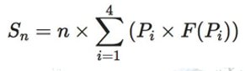
Information Entropy
Pi所需的存储空间
概率大的事件采用小的存储空间，也就是成反比，负相关，最简单的负相关就是取倒数
在公式中消除 除法，除法变减法，取对数！
(1)对数操作可以让原本不符合正态分布的模型符合正态分布，比如随着模型自变量的增加，因变量的方差也增大的模型取对数后会更加稳定;
(2) rescale
Notes:
概率大的事件采用小的存储空间，也就是成反比，负相关，最简单的负相关就是取倒数

Slide 44
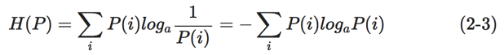
Information Entropy
变为
根据真实分布，我们能够找到一个最优策略，以最小的代价消除系统的不确定性（比如编码），而这个代价的大小就是信息熵。
Notes:
信息熵其实从某种意义上反映了信息量存储下来需要多少存储空间。

Slide 45
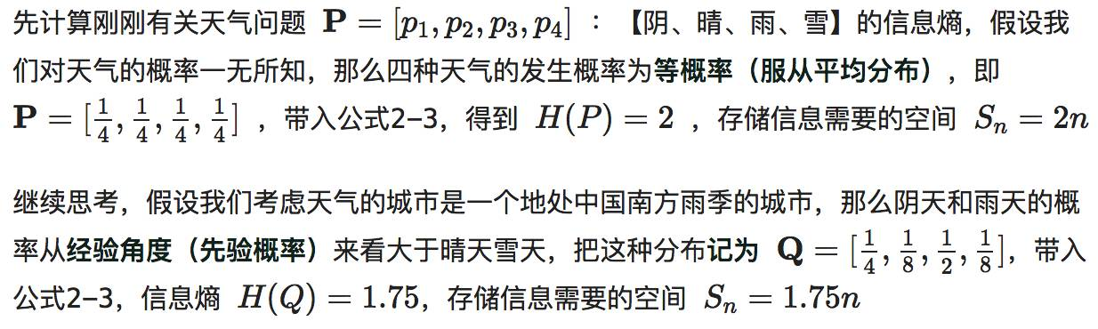
Information Entropy
Notes:
信息熵是信息量的期望（均值），它不是针对每条信息，而是针对整个不确定性结果集而言，信息熵越大，事件不确定性就越大。

Slide 46
3. What is the design principal of network?
Packet switching provides more paths to minimize the entropy
Notes:
从某种意义上，Internet可以说是美苏冷战的产物。美国国防部认为，如果仅有一个集中的军事指挥中心，万一这个中心被原苏联的核武器摧毁，全国的军事指挥将处于瘫痪状态，其后果将不堪设想，因此有必要设计这样一个分散的指挥系统——它由一个个分散的指挥点组成，当部分指挥点被摧毁后其它点仍能正常工作，而这些分散的点又能通过某种形式的通讯网取得联系。

Slide 47
3. What is the design principal of network?
Packet switching provides more paths to minimize the entropy
“我认为世界历史可以用两句话来描述：分久必合，合久必分。我们的互联网行业也体现了这一种规律。过去，美国网络的资源几乎被 AT&T 一家垄断，这和当时候的网络技术Circut Switching 有很大的关系。最初，AT&T 也面临过一定的竞争，但等到公司足够大，效率和规模足够优秀，最后就会出现一家垄断的现象……
但是，往往技术的发明会导致合久必分。 TCP/IP 协议的发明，就促进了互联网时代的到来，Packet Switching 取代了 Circuit Switching。
当合久必分的局面持续了一段时间后，人们发现一个问题：虽然最底层的网络通讯非常去中心化，大家也会在每个网站发表自己的信息，但是对整个信息没有一个系统的组织架构，这使得信息很难被找到。在这种需求的推动下，美国就出现像谷歌这样中心化的一个搜索公司。
它做的事情和我们过去在工业时代做的事情几乎一样：只是把重组原子改为重组信息。比如大型石油公司开采原油，而原油也是一些原子组成的。石油公司的做法近乎于将原子重新组织了一下，将它变成了化学品。像谷歌这样的新一代企业，它们擅长的是重组那些 Bits、信息。谷歌并没有建立那些网站，而是利用自己的算法，对已有的网站进行排序，使得每个公司都能在这个网络世界里被很容易地找到……” --------张首晟
Notes:
一个系统在逐渐地从有序变为无序，再逐渐地变为有序，周而循环，熵增给系统带来更多可能

Slide 48
3. What is the design principal of network?
The Growing of Internet
Hidden factors
Entropy is additive
Social/Commercial
Ecosystem
Notes:
商业驱动 促使技术的极大发展

Slide 49
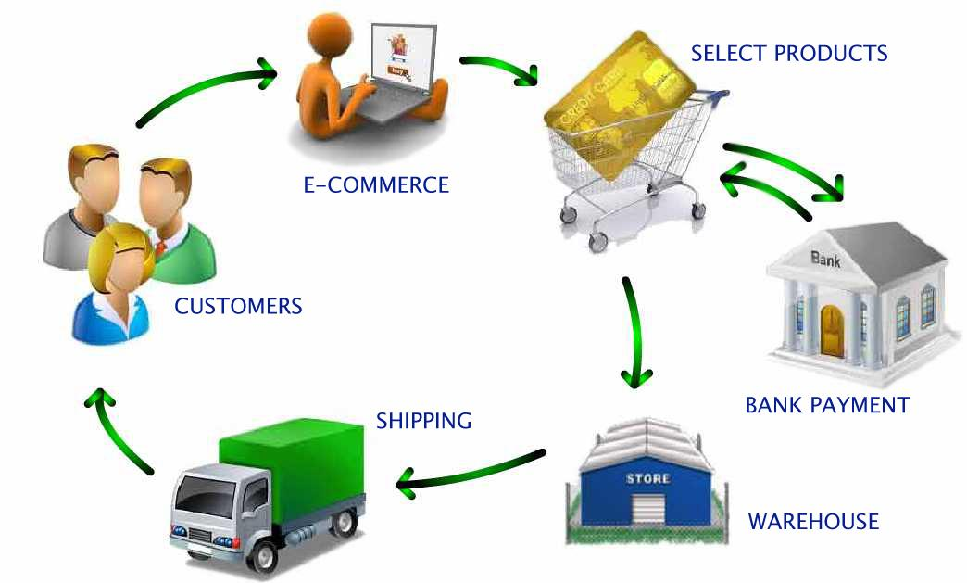
3. What is the design principal of network?
Social/Commercial
Notes:
以电商为例，其通过对传统商场的冲击，转移其部分利润，其熵增对应了商场的熵减

Slide 50
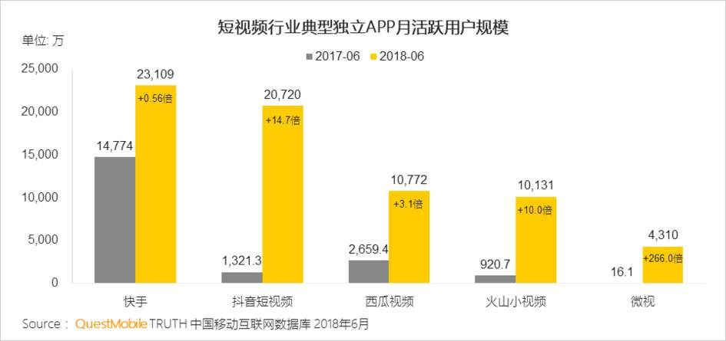
3. What is the design principal of network?
Social/Commercial
Notes:
从传统商场 到淘宝等图文式页面，再到短视频，一个新的平台通过分割既有系统的熵值来获得自己的活力

Slide 51
3. What is the design principal of network?
The Growing of Internet
Hidden factors
Entropy is additive
Social/Commercial
Ecosystem

Slide 52

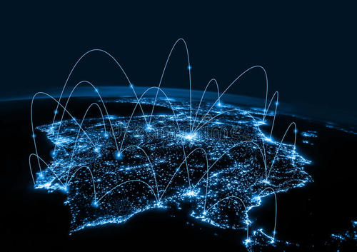
3. What is the design principal of network?
Ecosystem
IoT
Notes:
人类通过计算机网络来获得对外部世界的熵增，物联网是典型的一个产物；
通过熵增思想，我们能产生什么新的想法？针对一个场景，我们可以做出自己的创新；当然，是否存在一个终极的时间，人类对外熵增到极限而趋于灭亡？

Slide 53
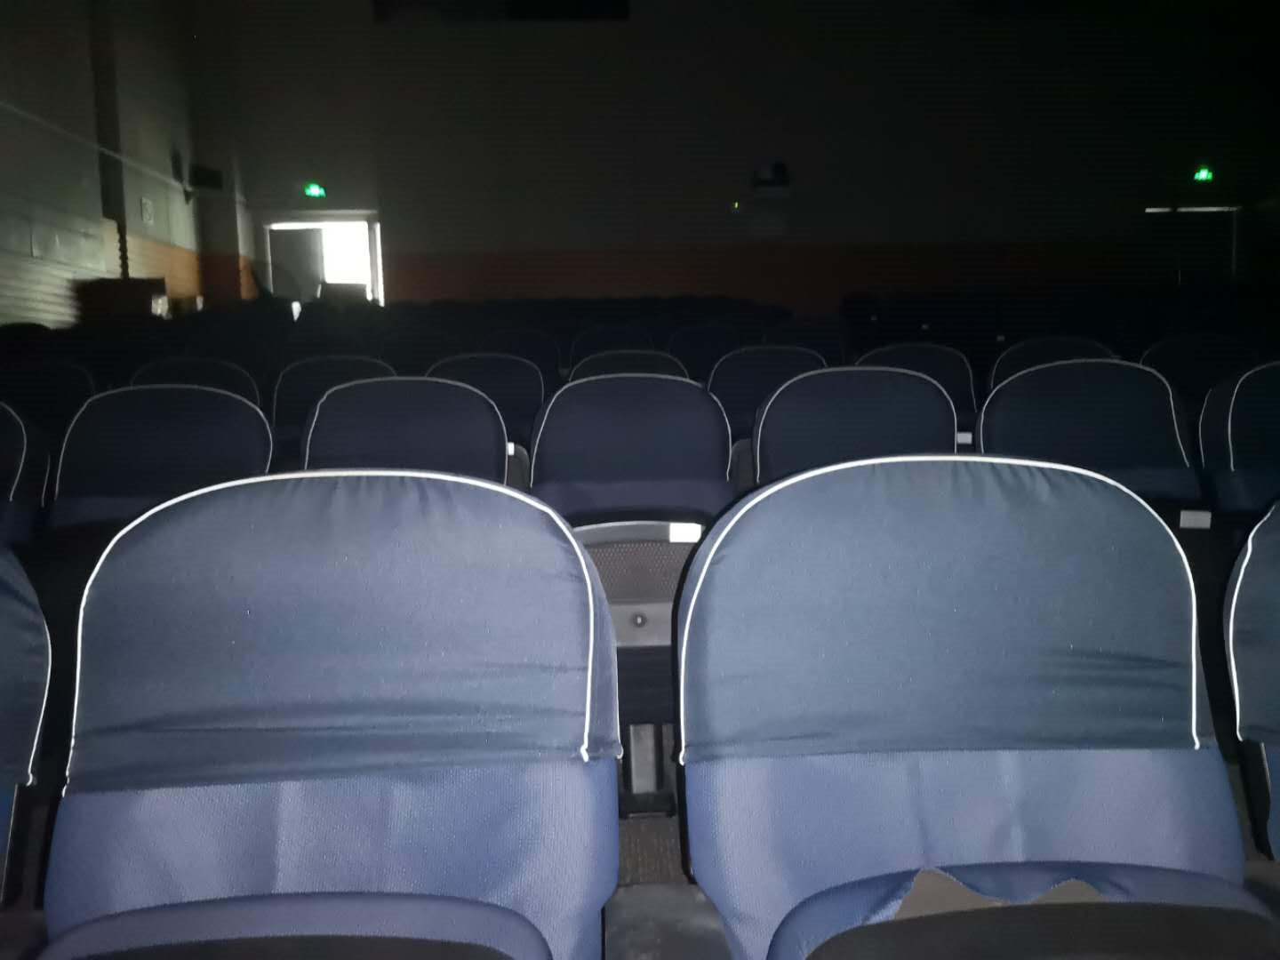
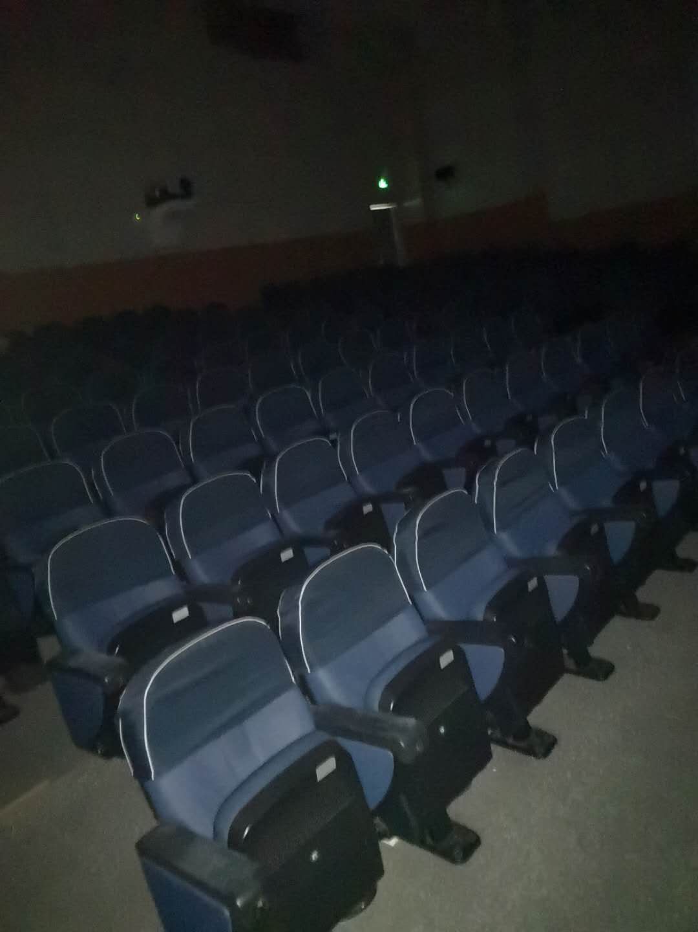
An example
CMAX智能盒子方案
座椅靠背 V.S. 侧墙
距离0.6-2米
7人
距离0.6-2米
7人
距离2-8米
21-25人
距离2-8米
21-25人
方案 | 距离 | 人数 | 精度 | 声音 | 300人用量 | 安装方式
座椅靠背 | ≤2米 | 7 | 精确表情 | 单人 | 43 | 改造座椅
侧墙 | ≤8米 | 21-25 | 面部朝向 | 群体 | 15 | 贴墙固定
扶手按钮
Notes:
物联网的在研课题

Slide 54
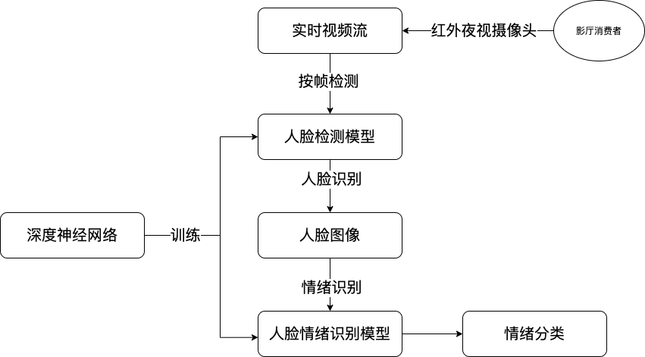
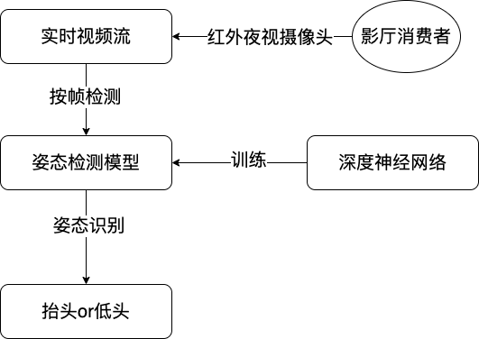
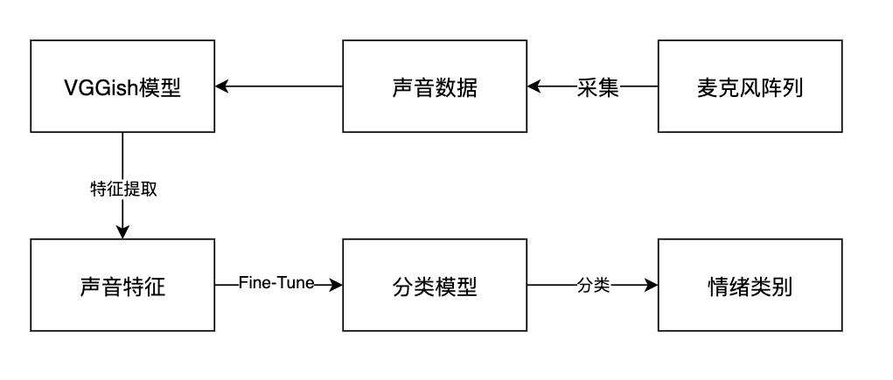
An example
基于视频和声音的情绪识别算法
面部情绪识别
肢体动作识别
声音情绪识别

Slide 55
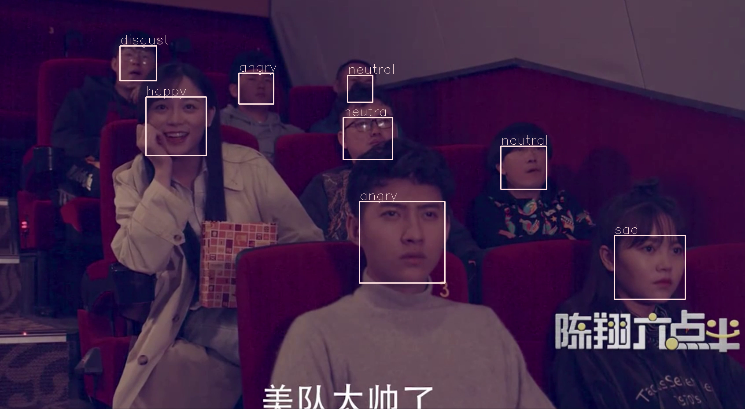
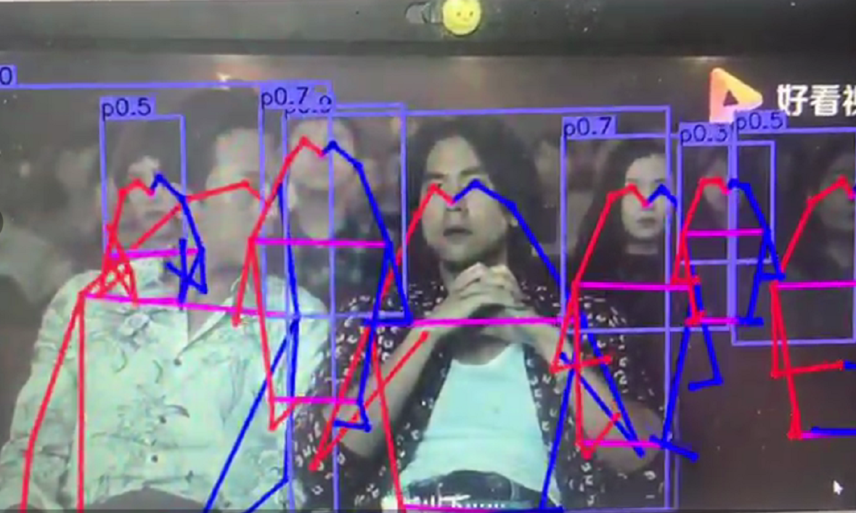
An example
多模态情绪识别技术
面部表情情绪识别
肢体动作识别

Slide 56
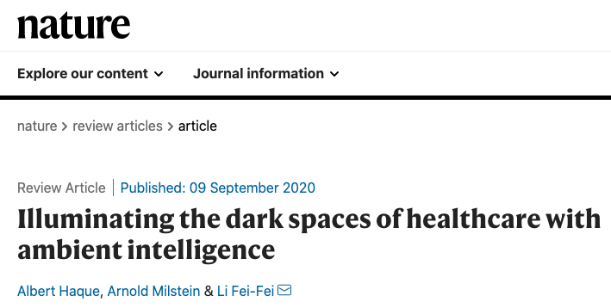

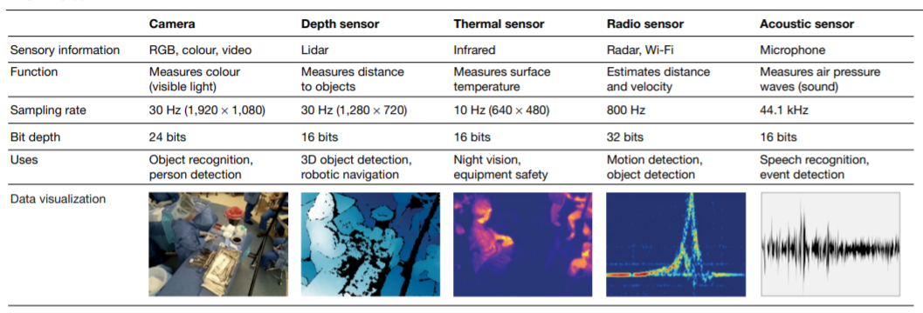
3. What is the design principal of network?
Notes:
李飞飞教授在其发表的文章「Illuminating the dark spaces of healthcare with ambient intelligence」中回顾了这项技术如何改善我们对隐性黑暗的，未观察到的医疗空间的理解。参考链接：https://mp.weixin.qq.com/s/prCffCFlIhDoWEcW5gIxYQ

Slide 57
3. What is the design principal of network?
Design principal
trade off
Node centrality, Node influence
Connectedness
Size, Density, Average degree
Average shortest path length (or characteristic path length)
Optimal path
Throughout, Delay
……
Notes:
不局限于过去40年间计算机网络的架构，可以针对具体场景进行新的设计

Slide 58
Chapter 1 Introduction
1. What is a network？
2. What is computer network?
3. What is the design principal of network?
4. What is advanced network？
5. Syllabus

Slide 59
4. What is advanced network？
Deep comprehensive of design principal
distribute
end to end
How to optimize the network stack?
What to do in the future？

Slide 60
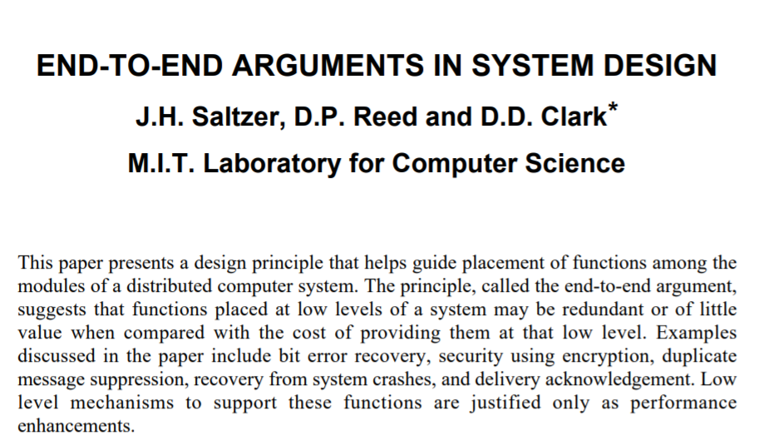
4. What is advanced network？
Deep comprehend of design principal
Distribute / end to end

Slide 61
4. What is advanced network？
Deep comprehend of design principal
Distribute / end to end
数据与分层模型
计算机 1
计算机 2
AP₁
应用层首部
应 用 程 序 数 据
AP₂
5
运输层首部
5
H₅
应 用 程 序 数 据
网络层首部
4
H₄
H₅
应 用 程 序 数 据
4
链路层
首部
链路层
尾部
3
H₃
H₄
H₅
应 用 程 序 数 据
3
2
H₂
H₃
H₄
H₅
应 用 程 序 数 据
T₂
2
1
10100110100101 比 特 流 110101110101
1

Slide 62
4. What is advanced network？
Deep comprehend of design principal
Distribute / end to end
application
transport
network
data link
physical
application
transport
network
data link
physical
1. send datagrams
2. receive datagrams

Slide 63
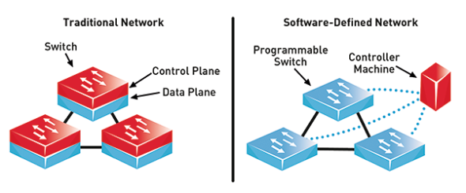
4. What is advanced network？
Deep comprehend of design principal
Distribute / end to end

Slide 64

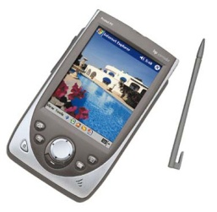

4. What is advanced network？
How to optimize the network stack?
Indirection via “Proxy”
Proxy bridges the server and the client
Move complexity away from both server and client
Generalized end-to-end argument: “edge” rather than “end” systems
Little changes at server & client
server
proxy
client

Slide 65
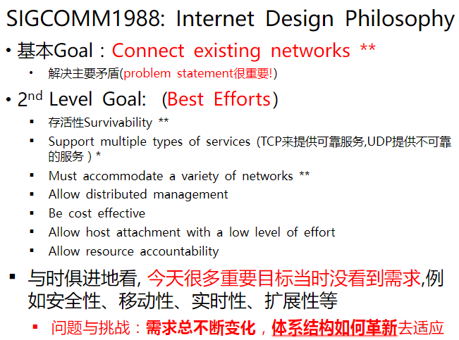
4. What is advanced network？
How to optimize the network stack?

Slide 66
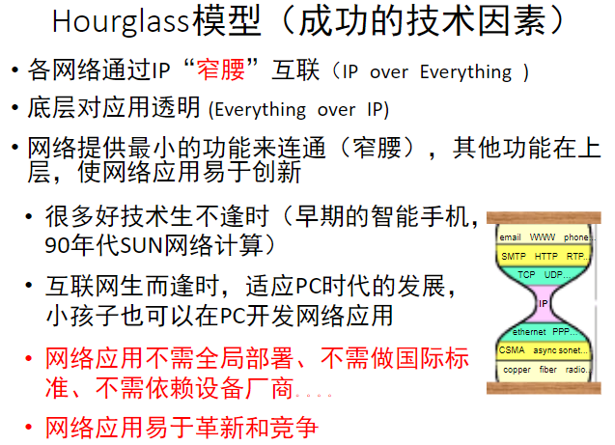
4. What is advanced network？
How to optimize the network stack?

Slide 67
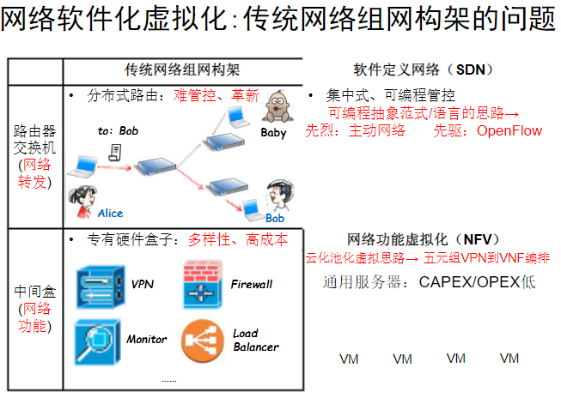
4. What is advanced network？
How to optimize the network stack?

Slide 68
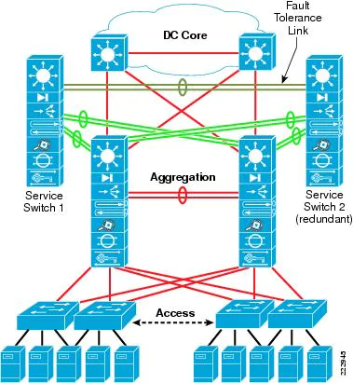
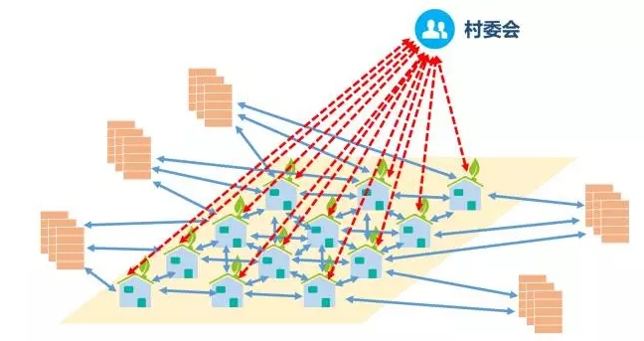
4. What is advanced network？
How to optimize the network stack?
图片来源: https://pic3.zhimg.com/v2-4e60e6392940d1ae9ddc6a988fafc24f_r.jpg?source=1940ef5c

Slide 69
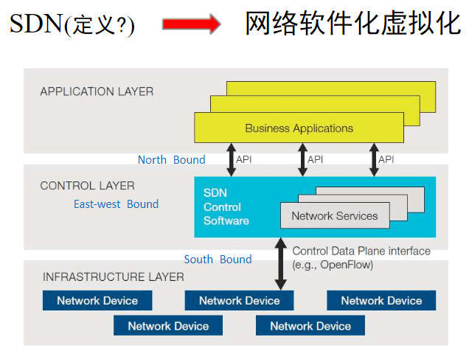
4. What is advanced network？
How to optimize the network stack?
Notes:
应用层，控制层，基础设施层

Slide 70
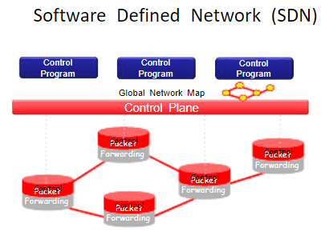
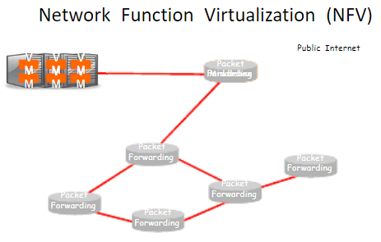
4. What is advanced network？
How to optimize the network stack?

Slide 71
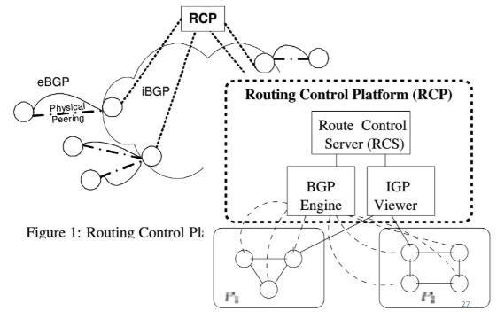
4. What is advanced network？
How to optimize the network stack?

Slide 72
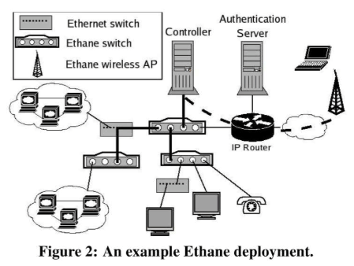
4. What is advanced network？
How to optimize the network stack?
Notes:
Stanford

Slide 73

4. What is advanced network？
How to optimize the network stack?
Notes:
Stanford

Slide 74


4. What is advanced network？
How to optimize the network stack?
Notes:
数据平面和控制平面分离后，左图是数据平面缓存流的控制规则，右图是协议格式

Slide 75
4. What is advanced network？
what to do in the future?
IPv6
5G/6G
Wireless Network
IoT
……

Slide 76
Drivers for Wireless Research
New Applications,
Services, Requirements
Top
Up
Transport Layer
Network Layer
Down
Link Layer
Bottom
New Wireless
Communications Technology

Slide 77
Top Down Driver: User Demand
Many of them:
New applications
MMS, P2P image/video sharing, IP TV streaming, …
New requirements
Security, privacy, robustness/dependability, distributed management
New services
Location-based service, Personalized service, …
New trends
Interoperability of different wireless technologies
Challenge: How to support such new demands?

Slide 78

Top Down Driver: User Demand
思贤楼实验实例

Slide 79
Chapter 1 Introduction
1. What is a network？
2. What is computer network?
3. What is the design principal of network?
4. What is advanced network？
5. Syllabus

Slide 80

Syllabus

Slide 81
Courses
Theory teaching：50 hours，8 weeks
Experiment courses：20 hours，5 times
score ：
test (closed book)： 60%
experiment and homework: 40%

Slide 82
experiment courses
Exp1. Packet sniffer and analysis based on Wireshark
Exp2. Development of e-mail protocol(SMTP/POP3)
Exp3. Socket programming
Exp4. Routing based on RouteSim
Exp5. ……

Slide 83
Teachers or advisers
赵振刚 http://staff.ustc.edu.cn/~gavin/
gavin@ustc.edu.cn
思贤楼507(西区学生食堂电梯上5楼右手边)
0512-68839303

Slide 84

Syllabus
textbook

Slide 85


Syllabus
Readings

Slide 86



Syllabus
Readings
Notes:
W. Richard Stevens(1951-1999)

Slide 87


Syllabus
Protocol analysis tools
http://www.wireshark.org/
Notes:
WinPcap是用于网络封包抓取的一套工具，可适用于32/64位的操作平台上解析网络封包，包含了核心的封包过滤，一个底层动态链接库，和一个高层系统函数库，及可用来直接存取封包的应用程序界面

Slide 88

Syllabus
Codes analysis 4.4BSD
Notes:
WinPcap是用于网络封包抓取的一套工具，可适用于32/64位的操作平台上解析网络封包，包含了核心的封包过滤，一个底层动态链接库，和一个高层系统函数库，及可用来直接存取封包的应用程序界面

Slide 89

Syllabus
Request For Comments
http://www.ietf.org/rfc.html
Notes:
翻开网络标准文档RFC，已经更新到了6000多篇，哪个人也没有精力将这么多的RFC 吃透，通过SDN可以将人们从浩瀚的网络协议中解脱出来，只有设计网络设备的人才用关心网络协议的使用，使用网络设备的人，只要通过SDN控制，就不用再关心网络底层的实现。

Slide 90
Standards Organizations
→ 行动缓慢，按章办事
Standards Creation Committees
ISO（International Standards Organization，国际标准化组织）
ITU-T（International Telecommunications Union – Telecommunication Standardization Sector，国际电联 --电信标准部）
ANSI（American National Standards Institute，美国国家标准化局）
IEEE（Institute of Electrical and Electronics Engineering，电气电子工程师学会）
EIA（Electronic Industries Association，电子工业协会）

Slide 91
Cont.
→ 加快标准化过程，测试、评价、标准化新技术
Forums
Frame Relay Forum（帧中继论坛）
ATM Forum（ATM论坛）
Regulatory Agencies
FCC（Federal Communications Commission，联邦通信委员会）
Internet标准—— RFC（Request For Comments）
http://www.rfc-editor.org

Slide 92
Internet Standards
RFC（Request For Comments）
请求评论、请求注解、请求注释
http://www.rfc-editor.org
The RFC document series is a set of technical and organizational notes about the Internet (originally the ARPANET), beginning in 1969. Memos in the RFC series discuss many aspects of computer networking, including protocols, procedures, programs, and concepts, as well as meeting notes, opinions, and sometimes humor.

Slide 93

Maturity Levels of an RFC
RFC2026：The Internet Standards Process -- Revision 3

Slide 94
Example：RFC Index
0790 Assigned numbers. J. Postel. Sep-01-1981. (Format:
TXT=35316 bytes) (Obsoletes RFC0776) (Obsoleted
by RFC0820) (Status: HISTORIC)
0791 Internet Protocol. … (Status: STANDARD)
1256 ICMP Router Discovery Messages. … (Status:
PROPOSED STANDARD)
1460 Post Office Protocol - Version 3. … (Status: DRAFT
STANDARD)
1788 ICMP Domain Name Messages. … (Status:
EXPERIMENTAL)
1878 Variable Length Subnet Table For IPv4. … (Status:
INFORMATIONAL)

Slide 95
Requirement Levels of an RFC
RFC 2119 ：
Key words for use in RFCs to Indicate Requirement Levels
Required
Recommended
Elective
Requirement levels
Limited use
Not recommended
"MUST", "MUST NOT", "REQUIRED", "SHALL", "SHALL NOT", "SHOULD", "SHOULD NOT", "RECOMMENDED", "MAY", and "OPTIONAL"

Slide 96
Internet Administration
IRTF：Internet Research Task Force
因特网研究部
ISOC
Internet Society
因特网协会
Internet Architecture Broad
因特网体系结构研究委员会
IAB
IRTF
IRSG
IETF
IESG
…
Area
Area
…
…
…
RG
RG
WG
WG
WG
WG
IETF：Internet Engineering Task Force，因特网工程部
IANA：Internet Assigned Numbers Authority，因特网编号管理局
ICANN： Internet Corporation of Assigned Names and Numbers

Slide 97
Summary
Protocol（协议）
概念，要素
Standard（标准）
概念，种类
Internet
标准：RFC
历史、结构、管理机构
区别
Internet vs. internet

Slide 98
Thanks

